Slide 1
Lec 6
Tabular Method
Dr Hiba omer

Slide 2
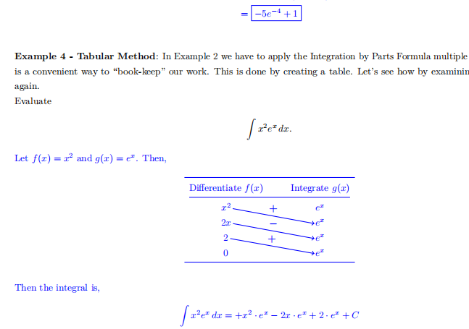

Slide 3
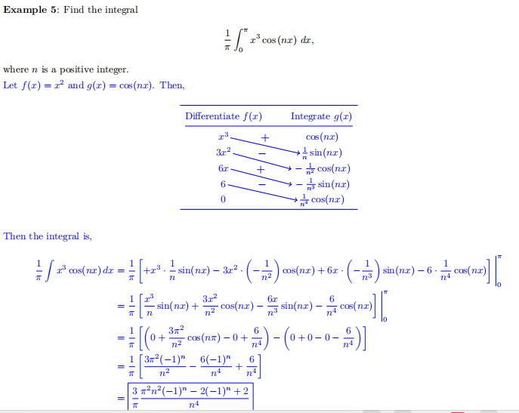

Slide 4
